Slide 1
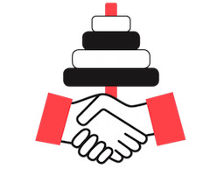
Discrete Math Project Collaborative
Ways of Thinking vs.
Ways of Understanding
https://dmpc.sdsu.edu/

Slide 2
Agenda
Let’s do some math!
Circling Back to “Ways of Thinking and Mathematical Practices”
“5 Practices for Orchestrating Productive Mathematics Discussions”
Reflection

Slide 3
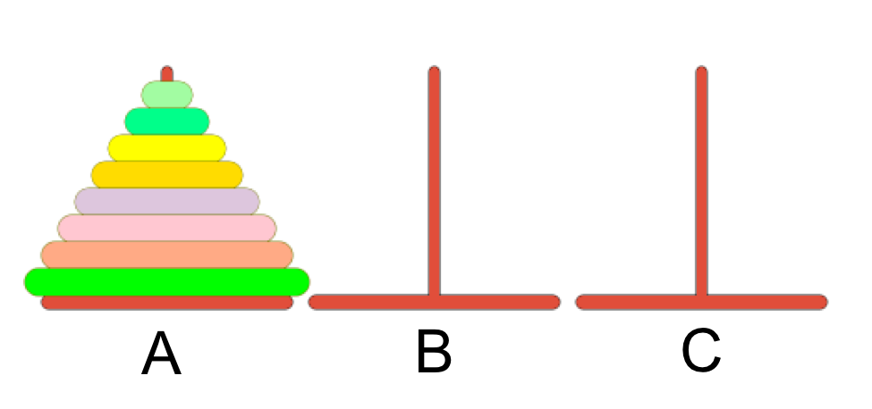
Tower of Hanoi
You are given a stack of 8 disks arranged from largest on the bottom to smallest on top, placed on a pole.
The goal is to move the stack of disks from the left-most pole (A) to the right-most pole (C) with the following conditions:
Only one disk may be moved at a time.
A larger disk may not be put on top of a smaller disk.
What is the minimum number of moves needed to move all 8 disks to pole C?

Slide 4
“Ways of Thinking and Mathematical Practices” by Lockwood and Weber
SMCs
SMPs
What standards for mathematical content did we address through the Tower of Hanoi problem?
What standards for mathematical practice did we engage in through the Tower of Hanoi problem?

Slide 5
Mental Acts
What mathematical activities does this problem target? (e.g. defining, meaning-making, pattern finding, generalizing, conjecturing, justifying/proving, symbolic manipulation, interpreting, inferring, explaining, structuring, applying, predicting, classifying, searching, problem solving, etc. )

Slide 6
“5 Practices for Orchestrating Productive Mathematics Discussions”
Anticipating: Multiple solutions before teaching, student thinking
Monitoring: Seating chart, tracking, anticipated solutions/ways of thinking
Selecting: Using goals, handling errors (equity and agency)
Sequencing: Long-term goals (chapter & year), progression of ideas, address misconceptions (equity and agency), from concrete to abstract
Connecting: Focus on meaning & linking approaches, make ways of thinking explicit, connecting representations

Slide 7
Reflection & Evaluation
https://tinyurl.com/sdsu-towerofhanoi
How did you feel about the mathematics we did today?
What do you view as the benefits of today’s class?
What would you like to know more about?
What suggestions do you have for us to improve our lesson?

Slide 8
DMPC Course Overview
Major goals:
To help students acquire knowledge of fundamental mathematics (Statement of Competencies in Mathematics, ICAS)
To advance students’ ways of thinking (CCSS Standards for Mathematical Practice)
To foster students’ mathematical curiosity and to demonstrate how mathematics can solve authentic mathematical problems.
To facilitate students’ development of problem-solving skills, while fostering critical thinking, within an interesting setting.

Slide 9
DMPC Course Overview
Games
Graph Theory
Counting
Iteration & Recursion
Cryptography

Slide 10
Beliefs About Learning
Problem-solving and productive struggle are keys to knowledge construction
Students need MANY opportunities to define, model, generalize, conjecture and justify
Teachers should view students as partners in knowledge construction
Learners should experience phenomena before labels are introduced
Learning is both social and cognitive in nature
Group tasks should be group worthy
Teachers are orchestrators of discourse

Slide 11
For more info about DMPC…
Website: https://dmpc.sdsu.edu/
Emails:
Dr. Osvaldo Soto – osoto@sdsu.edu
Melody Morris - melody.morris@sweetwaterschools.org
Anne Marie Almaraz -AnneMarie.Almaraz@sweetwaterschools.org
Trang Vu – tkvu1992@gmail.com
Clara Mateo – clarakmateo@gmail.com

Slide 12
More Opportunities to Engage in Discrete Mathematics
Saturday, April 13, 2019, 8:00 AM-1:00 PM.
Saturday, May 11, 2019, 8:00 AM-1:00 PM.
Summer Institute: TBA
To register, visit website: https://dmpc.sdsu.edu/

Slide 13
Investigate 1.2.3 - Pave the Way
You have a large collection of 1x1 blue square tiles and 1x2 green tiles. You want to pave a 1x20 walkway. In how many ways can you do this?

